Slide 1
Technology and Democracy
ELEG 491

Slide 2
What do we mean by ‘democracy’?
A “continuum” concept: individual choice in government decisions
Ancient Greece: The demos were the commoners—not necessarily “majority rule”
Direct Democracy <> Plebiscitarian?
Representative Democracy <> Republican?
Arrow’s “Impossibility Theorem”: There is no one “reasonable” procedure to derive social choice from individual choice

Slide 3
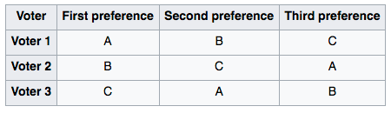
Condorcet Paradox, Majority Rule, and Non-Transitivity

Slide 4
Problems for Democracy because of IT?
The “digital divide” separates the information “haves” and “have-nots”
These divides exists between nations and within nations on: gender, education, race, (dis)ability, income, etc.

Slide 5
Digital Divide (Continued)
What is “having” or “not having” w.r.t. tech?
access to information technology
the knowledge and ability to use that technology

Slide 6
The Global Digital Divide
In 2000, it was estimated that 361 million people (approximately 6% of the world's population) were online globally.
68% of those online in 2000 lived in North America and Europe.
Two billion people in the world didn’t even have electricity, and in developing countries, there were roughly 69 phones for every 1000 people (2000 Human Development Report).

Slide 7
Some Statistics on IT Growth: 2000-2019
Global Internet usage more than doubled between 2000 and 2005.
In late 2005, it was estimated that there were more than 972 million Internet users.
By 2005, seven nations had an Internet penetration rate of higher than 60%, and the list of countries or regions where more than 50% of the population used the Internet had grown to 30).
By 2014, there were 3 billion internet users, and as many mobile phones as people on the planet.
In 2016, the World Economic Forum declares a “Fourth Industrial Revolution” in which economic growth correlates with IT growth
By 2019 there were 4.13 billion internet users.

Slide 8
IT-related political issues
Auto-indoctrination
Personalization filters (echo chamber effect)
Mass dispersion of half-truths (and lies)
Commenting/Trolling
Information overload
Data mining to make the voter=“the product”

Slide 9
Impact of IT on Democracy
Two different kinds of questions:
Has IT thus far enhanced democracy and democratic ideals, or has it threatened them? (What are the ideals?)
What impact has IT had on the political-election processes in democratic nations?

Slide 10
IT Impact: Political Elections in Democratic Nations
Three broad (and merging) worries:
electronic devices and social media sites influence political outcomes
political blogs spread false information and influence election outcomes.
government masters the dark arts of propoganda

Slide 11
Carothers: Why hasn’t IT helped Democracy?
Summary:
It is too soon to tell—some changes may be “local”
Large, countervailing trends (e.g. authoritarianism)
IT itself doesn’t mobilize “collective action”

Slide 12
E.g., consider Rakesh Rajani’s critique
“The Gutenberg press, the ballot box, and the Twitter feed are wonderful inventions to propel democratic impulse. But we fetishize them at our own peril. The truly revolutionary aspect of human revolutions is the hard work of forging collective belief and action.”
(Cf. television’s “watershed moments”: 1960 Kennedy-Nixon debates and the 1968 Democratic National Convention)

Slide 13
The Use of Electronic Devices and Social Media
Consider the “Arab Spring” – a political movement that began in January 2011 in Cairo, Egypt.
Protestors threatened to bring down the government, so the Mubarak administration shut down the country’s Internet services and mobile phone resources.
But the protestors had already planned demonstrations via Facebook and Twitter before the online services in Egypt could be shut down.

Slide 14
Marcuse’s Response: The “machine process” may yet set us free!
What exactly is the “machine process” and what is its relation to democracy?
“A comfortable, smooth, reasonable, democratic unfreedom prevails in advanced industrial civilization, a token of technical progress.”
…
“The people recognize themselves in their commodities; they find their soul in their automobile, hi-fi set, split-level home, kitchen equipment. The very mechanism which ties the individual to his society has changed, and social control is anchored in the new needs which it has produced.”

Slide 15
Some “big ideas” from Marcuse
Rational “industrial” development can both supply and deprive freedom
Technological progress can make us (voluntarily) part of ”the machine”
The “machine process” integrates all aspects of work, culture, and leisure
Potentially, automation can satisfy all our “needs” and make us “free”

Slide 16
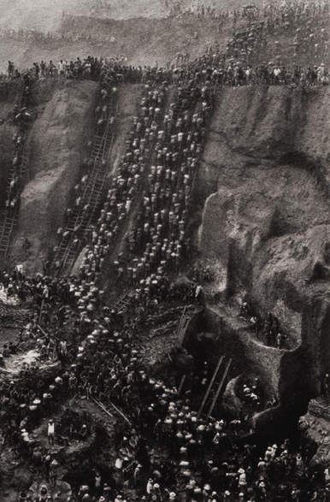

Slide 17
Marcuse’s “machine process”
“Today political power asserts itself through its power over the machine process and over the technical organization of the apparatus. The government of advanced and advancing industrial societies can maintain and secure itself only when it succeeds in mobilizing, organizing, and exploiting the technical, scientific, and mechanical productivity available to industrial civilization. And this productivity mobilizes society as a whole, above and beyond any particular individual or group interests. The brute fact that the machine's physical (only physical?) power surpasses that of the individual, and of any particular group of individuals, makes the machine the most effective political instrument in any society whose basic organization is that of the machine process. But the political trend may be reversed; essentially the power of the machine is only the stored-up and projected power of man. To the extent to which the work world is conceived of as a machine and mechanized accordingly, it becomes the potential basis of a new freedom for man.”

Slide 18
No more labor?
“Advanced industrial society is approaching the stage where continued progress would demand the radical subversion of the prevailing direction and organization of progress. This stage would be reached when material production (including the necessary services) becomes automated to the extent that all vital needs can be satisfied while necessary labor time is reduced to marginal time. From this point on, technical progress would transcend the realm of necessity…”

Slide 19
What might enable this “new freedom”?
Some emerging ideas:
Universal Basic Income
Automation of all production and agriculture
Transhumanism
…and maybe even the Kurzweil’s Singularity?

